Slide 1
Indeed Job Opportunities
Data Scientists:
Anchal Tewari
Angela Paiva
Fabio Maia
Felipe Teodosio
Larissa Madeira

Slide 2
Agenda
Project Overview
Web Scraping
Data Analysis
Questions

Slide 3

?
Have you started drawing out your Data Science roadmap?

Slide 4

The Idea!!

Slide 5

Web Scrapping Technique
70% of the Project
30% of the Project
Generating Indeed URL’s
Creating the Data Frame
Data Analysis +
Plotting Graphs
Analysis with MS Excel & SQL Lite
Lessons learned:
The more you manipulate the data on the Data Cleaning phase, the deeper are your analysis at the end.

Slide 6

Overview
767
Canada’s Data Science job opportunities analyzed
From:
Last retrieval date: 06/December/2018

Slide 7


Web scraping

Slide 8
How is the Data Science Job Marketing in Canada?

Slide 9
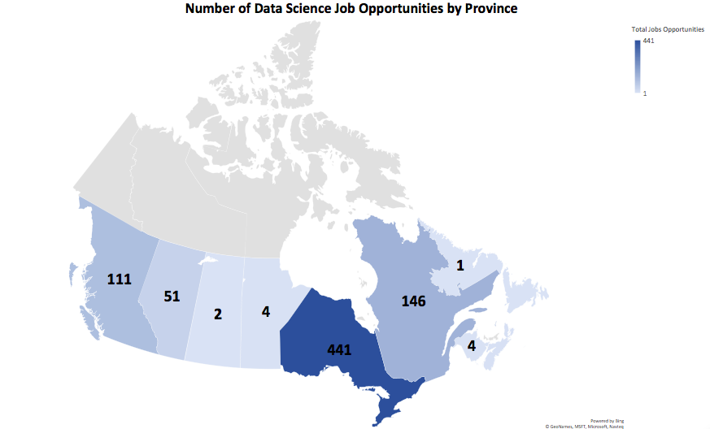
Data Science Job Opportunities by Province

Slide 10
Total Data Science Job Opportunities by Province

Slide 11
10 Cities with more opportunities
304
Data Science Job Opportunities in Toronto

Slide 12
What is the educational level companies are looking for?

Slide 13
Educational Level Required (Exclusively)
21 %
6 %
6 %
Only Bachelor
Master
PhD

Slide 14
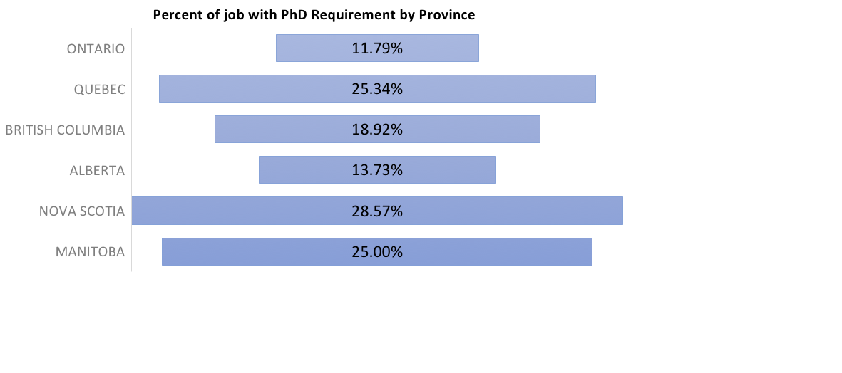
PhD requirement by province
The educational level required Ontario is less than all the others provinces

Slide 15
Type of Major required

Slide 16
Which hard skills data science job market is looking for?

Slide 17
Top 10 required Data Science
Hard Skills
48.9%
Python
37.0%
SQL
34.0%
Excel

Slide 18


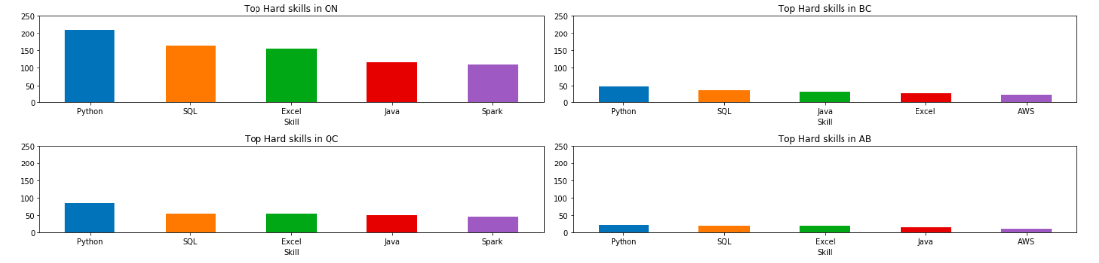
Top 5 required hard skills by main provinces
Python and Excel are the most important hard skills in all provinces
R is not as popular as Python

Slide 19
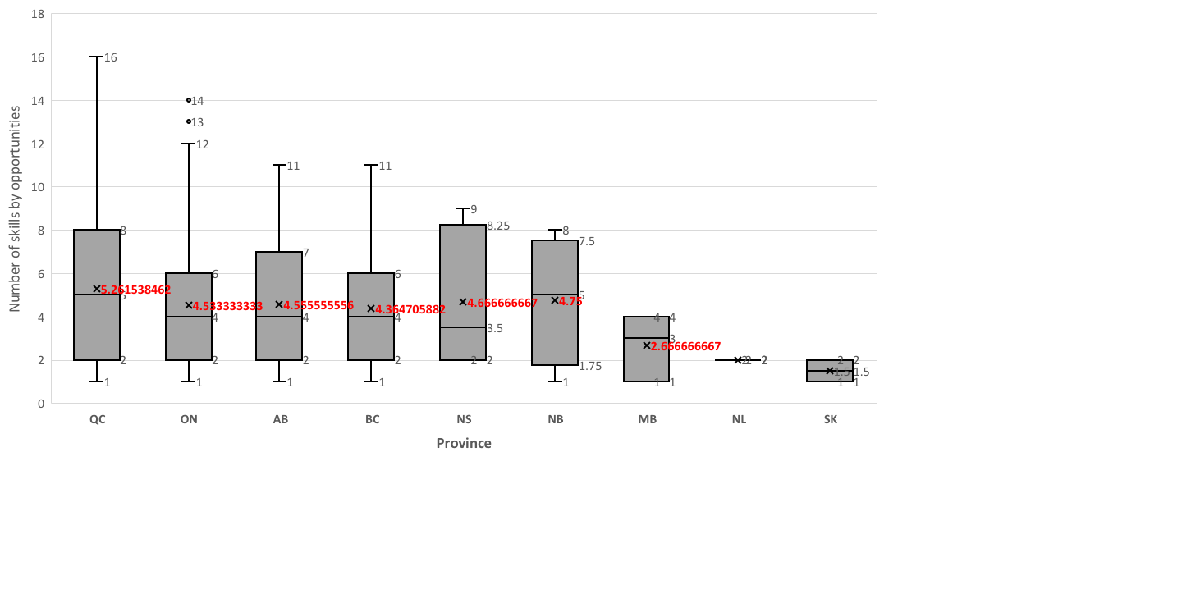
Number of hard skills required by job opportunities in each province

Slide 20
Who is hiring?

Slide 21
Company | City | # Job opportunities
Code Pilot | Toronto | 14
Scotiabank | Toronto | 12
gdR | Grossman Dorland Recruiting | Toronto | 11
WatrHub Inc. | Toronto | 10
Accenture | Toronto | 7
Flipp | Toronto | 7
Myant | Etobicoke | 6
Deloitte | Toronto | 5
HSBC | Toronto | 5
KPMG LLP | Toronto | 5
Loblaw Companies Limited | Brampton | 5
Aviva | Markham | 4
CIBC | Toronto | 4
Capgemini | Toronto | 4
Hashtag Paid | Toronto | 4
Intact | Toronto | 4
Procom | Toronto | 4
Shopify | Ottawa | 4
Allstate Canada | Markham | 3
BMO Financial Group | Toronto | 3
Some companies with more number of job opportunities in Ontario

Slide 22
How much companies are paying?

Slide 23
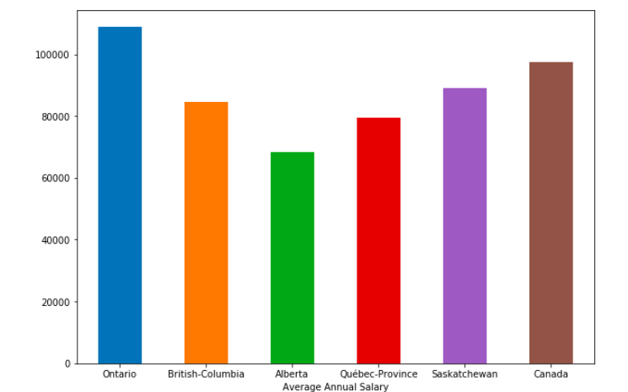
Average Annual Salary
Province | Annual Salary
Ontario | $ 108,747.00
British-Columbia | $ 84,550.00
Alberta | $ 68,263.00
Québec-Province | $ 79,473.00
Saskatchewan | $ 89,088.00
Canada | $ 97,596.00

Slide 24
How our Data Science program will help us to get a job?

Slide 25
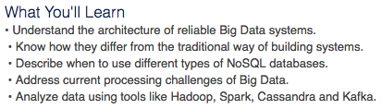
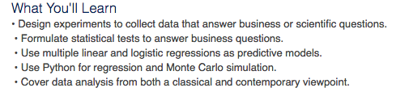

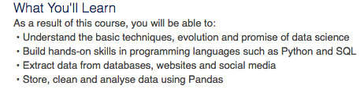
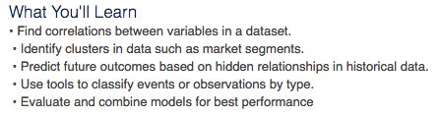
Data Science UoT program skills

Slide 27
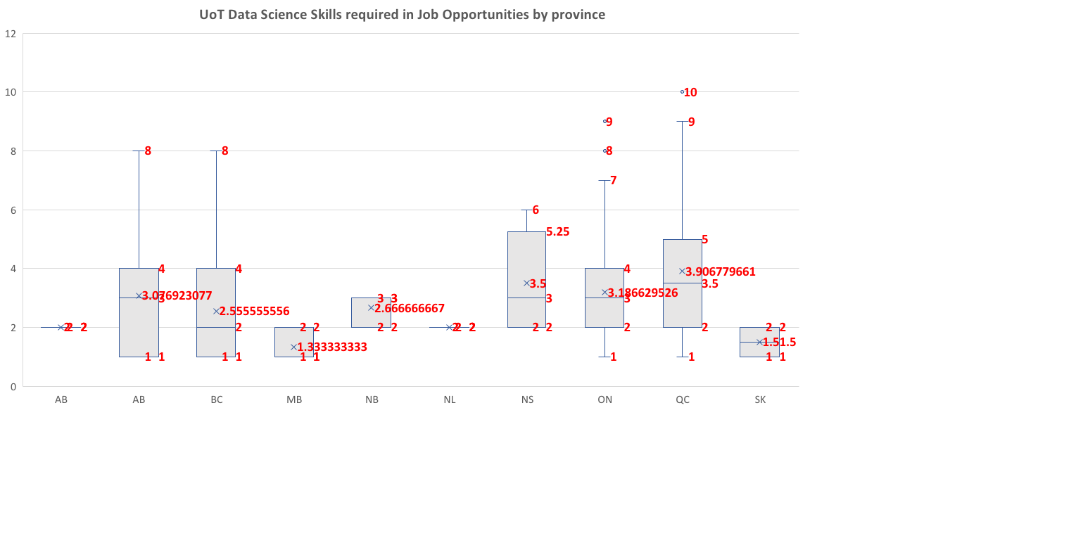

Slide 28
Who is the perfect professional for the Data Science job opportunities available?

Slide 29
HARD SKILLS: PYTHON, SQL, EXCEL, JAVA
EDUCATION: Bachelor (or more)
FIELD: Computer Science or Statistics or Mathematics or Artificial Intelligence
POSITION LOCATION: Toronto, ON
SALARY EXPECTATION: 80.000 – 95.000 / year
IDEAL
PROFESSIONAL

Slide 30


Thank you!
Questions?

